Slide 1

Interface Presentation
By spirits

Slide 2
Group members
Member | Roles
Jiazheng Pan | Project Manager and Liaison
Haotian Tang | Programmer and Requirement Analyst
Weibin Cheng | System Architect and Tester
Carlos | Tester

Slide 3
Main description
The main task of interface is to provide users with convenient access to back-end functions. Since we are divided into different groups to finish our own tasks, the interface group plays a role in dealing with users directly. Users’ requirements usually appear directly on the interface. They don’t need to know implementation details and just click the buttons to realize their requirements.
For our group, all we need to do is design the interface according to requirements and associate the buttons with APIs provided by server groups.

Slide 4
Function logic
Calibration data
Delete calibration
Put device/<uuid>/calibration
Cloud Server
Interaction
Get calibration/pending
Device Server
Calibration data
Motion lists
Head device/<uuid>/calibration
Get calibration
Data available?
Calibration data
Get /, Head /
Data
Commands
Delete device/<uuid>/calibration
User instructions
Device status
Database
Post calibration/motion

Slide 5
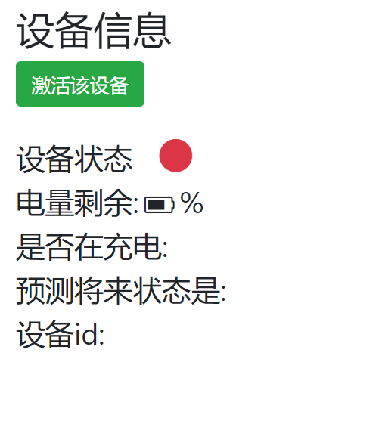
Corresponding to interface

Slide 6
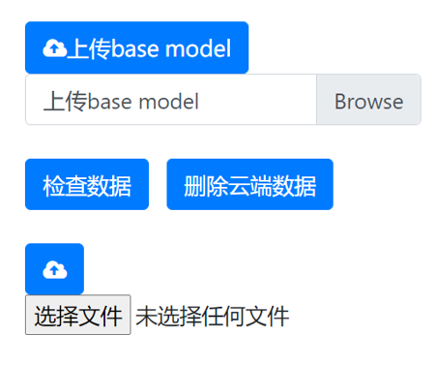
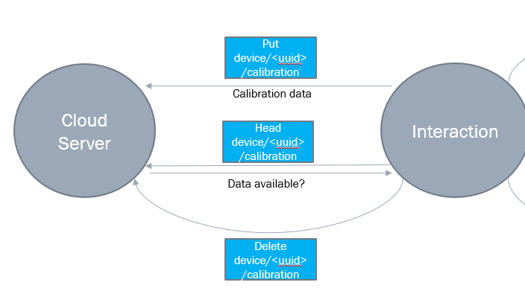
Corresponding to interface

Slide 7
Function logic
Algorithm Models
Get device/<uuid>/model
Cloud Server
Interaction
Get /model
Device Server
Current model on cloud
Current model on device
Head device/<uuid>/model
Put /model
New model
Model version
Delete device/<uuid>/model

Slide 8
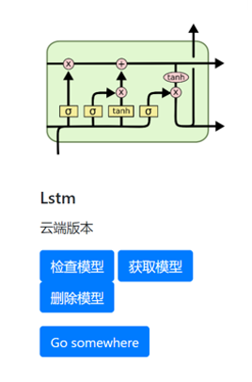
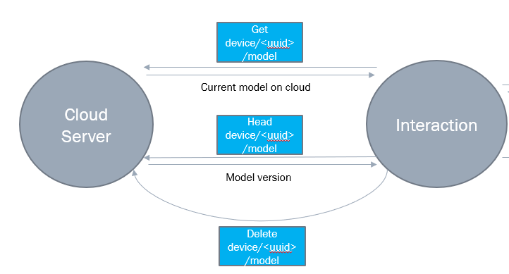
Corresponding to interface

Slide 9
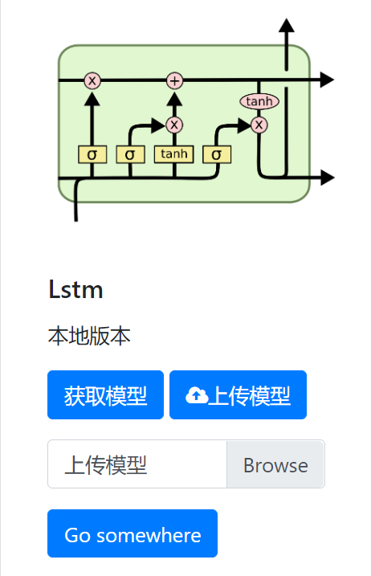
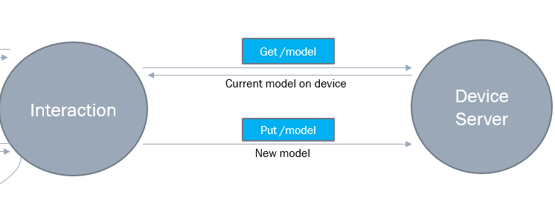
Corresponding to interface

Slide 10
Function logic
Binding email
Post device/<uuid>/email
Cloud Server
Contact email
Interaction
Get device/<uuid>/email
Current contact email
Delete device/<uuid>/email

Slide 11
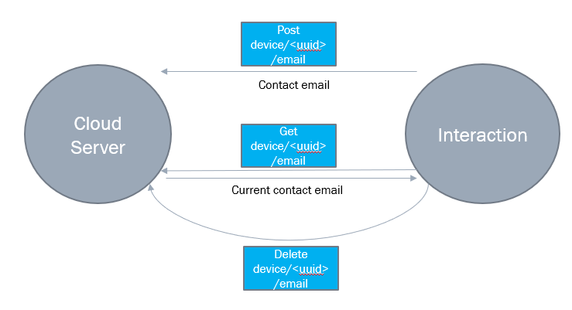
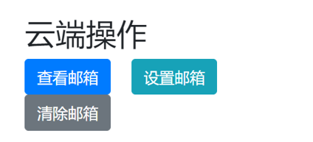
Corresponding to interface

Slide 12
Function logic
Administrator operations
Put model/base
Base model
Cloud Server
Put device/<uuid>/model
Interaction
New model
Get device/<uuid>/calibration
Calibration data
Delete device/<uuid>

